Slide 1
Ventilation fresh air with DX Coil
Daikin AHU
Notes:
CLICK We are glad in having the opportunity to present our new range of Daikin solutions for combining Air Handling Units with ERQ and VRV outdoor units. CLICK

Slide 2
Intro
DX Pair application of AHU
Control of DX AHU
DX Multi application of AHU
Review
Notes:
This training explores the possible combinations, the control patterns, the sales avantages. CLICK

Slide 3
1
Intro
What is an AHU?
Possible combinations
Merrits of DX AHU
Notes:
In this introduction we will review the main components of an air handling unit and remind about the possible combinations with different types of Daikin equipment. We will list some of the sales arguments in favour of the Air handling units using direct expansion coils. CLICK

Slide 4
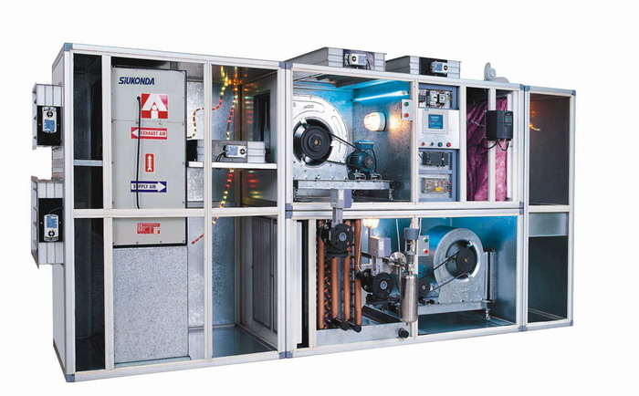

What is an AHU?
An AHU (Air Handling Unit) is a ventilation device connected to ductwork which distributes conditioned air throughout a building/space and returns it back (supply and return).
An AHU is normally a large ‘box’ containing fan sections, cooling and heating coils, filter racks/chambers, sound attenuators and dampers.
Daikin AHU can be designed with ASTRA software
The cooling/heating coils which run on refrigerant are called DX coils.
Notes:
Essentially, an Air Handling Unit is used to condition and circulate air as part of a HVAC system. More often than not, this takes the form of a ‘large box’ which contains fans, filters, louvers etc.
The AHU example is in two sections. The discharge side will send the conditioned air into ductwork sections, supplying it into the designated areas. The return air side, will bring the stale air in the space back to the AHU via return air ductwork. This air will then be ‘re-conditioned’ and re-circulated through the same process.The cooling and heating are mainly realized by coils. The coils which run on refrigerant are called Direct expansion coils or shortly DX coils.
Air Handling Units may have big dimensions compared with regular fancoils, therefore the cost of transportation is important. This, plus the fact that Air Handling Units are mainly made to order products , have encouraged local manufacturing.
There are few global AHU suppliers and Daikin is one of them. We produce Air Handling Units in the factories of Milan-Italy and Cramlington-UK. Daikin uses the ASTRA software for designing the Air Handling Units. CLICK

Slide 5
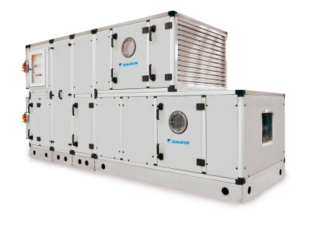
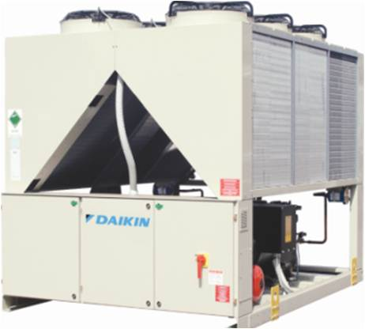
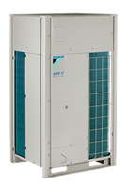
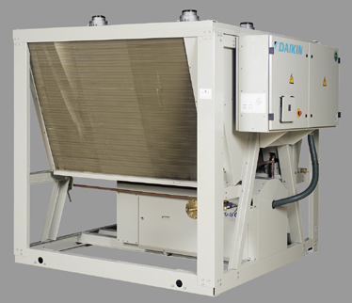
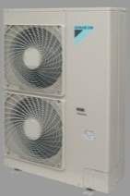
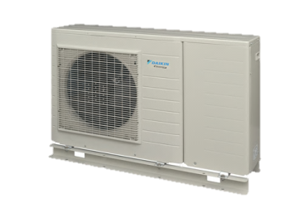
Applications of Daikin AHU
DX Coil
ERQ/VRV IV
ERAD
Water – Chiller
VRV IV
ERQ
OR
Notes:
The applications of Daikin Air Handling Units cover both Direct Expansion and Chilled Water Solutions. CLIC
Traditionally, Daikin have been able to provide condensing units that can connect onto the direct expansion coil encased within the AHU, and providing several control options in conjunction with this.
CLIC

Slide 6




Applications of Daikin AHU using DX coil
Daikin Condensing units product portfolio
ERAD-E-
VRV
ERQ
Cooling
11
28
100
150
420
kW
12
32
170
Heating
Notes:
CLICK A cost efficient solution for cooling capacities between 11 and 28 kW is to use a pair combination between an ERQ consdensing unit and an AHU equipped with a direct expansion coil.
For bigger capacities, combinations with VRV IV outdoor units can be used either on pair or multi application. CLICK All range of VRV IV consdensing units can be combined with Air Handling Units, in certain conditions.
Both ERQ and VRV IV can provide cooling and heating operation. C LICK
Different to this, the ERAD condensing units can provide cooling only, covering a capacity range between 100 and 420 kW.
The ERAD units are part of the applied systems range.
We will explain in the next slides the new ERQ and VRV IV combinations with DX-AHU. CLICK

Slide 7
Merits of connecting an AHU to ERQ or VRV IV outdoor
Immediate Cooling and Heating under any ambient or room conditions.
2) Better management of load for medium size spaces.
Used for fresh air ventilation or/and to cool/heat in light commercial applications
AHU can work together with other VRV indoor units in same system
extended operating range,
accurate temperature control
Quick switchover between cooling & heating.
Top Energy Efficiency / Low Operating Costs.
Energy saving due to inverter technology
VRV IV: VRT control is furthermore increasing seasonal efficiency
VRV IV: numerous settings targeting either higher efficiency or quick response.
4) Continuous Heating with VRV IV dedicated range:
Avoid Cold drafts during defrost cycle
fresh air can be continuously supplied at comfortable temperatures
Notes:
Compared with the traditional chilled water systems, the combination of Air Handling Units with ERQ and VRV IV bring together the advantages of direct expansion systems, like for example: CLICK
Low inertia, providing immediate cooling and heating under any ambient or room conditions CLICK
Ability to provide a complete air treament solution, in combination with other VRV indoor units
Quick switchover between cooling & heating CLICK
Energy efficiency, due to Inverter control of compressor and the VRT function CLICK
Compared with other similar solutions using DX coils, the VRV IV with continuous heating delivers more comfort during the defrost cycle. CLICK

Slide 8
2
DX-AHU
Pair application
Possible combinations
System components
Selection and design
Notes:
In this chapter we will review the components which are used in pair combinations between ERQ/VRV IV and Air Handling Units. We will also summarize the main steps for selection. CLICK

Slide 9
Pair application ERQ / VRV IV : possible combinations
Pair application = One outdoor unit + one expansion valve (EV) kit + one DX coil + one control box
Outdoor unit VRV IV | EV kit
RYYQ8T | EKEXV200 (CR90~110%)
RXYQ8T
RXYQQ8T
RWEYQ8T
RYYQ10T | EKEXV250 (CR90~110%)
RXYQ10T
RXYQQ10T
RWEYQ10T
RYYQ16T | EKEXV400 (CR90~110%)
RXYQ16T
RXYQQ16T
RWEYQ16T
RYYQ20T | EKEXV500 (CR90~110%)
RXYQ20T
RXYQQ20T
RWEYQ20T
Outdoor unit ERQ | EV kit
ERQ100 | EKEXV63/80/100
ERQ125 | EKEXV63/80/100/125
ERQ140 | EKEXV80/100/125/140
ERQ200 | EKEXV100/125/140/200
ERQ250 | EKEXV125/140/200/250
NEW IN 2015
Notes:
A pair combination consists in one outdoor unit coupled with a direct expansion coil which is part of an AHU. In order to integrate to the VRV system, the dx coil needs to be equipped with an expansion valve kit and a control box, provided by Daikin. The expansion valve kit code is EKEXV followed by a number indicating the size, similarto any VRV indoor unit. Depending of the size of the EV kit, different pair combinations are possible either with ERQ or with VRV IV outdoor units. The size varies from EKEXV 63 to EKEXV500. CLICK You may notice that sizes 400 and 500 were launched at the beggining of 2015, enlarging significantly the capacity range. For example, we have now the possibiity to connect a 20 HP VRV outdoor unit in a pair combination with a direct expansion coil having a cooling capacity of aprox. 60 kW. CLICK

Slide 10
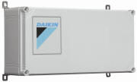
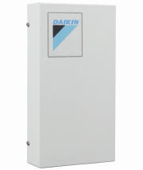
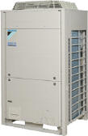
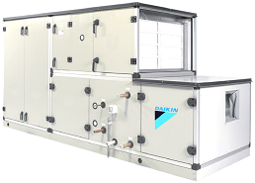
To control the temperature of the air leaving or returning to the AHU, by means of an external DDC device (X-W control) To control indirectly the room air temperature by fixing Te or Tc (Y control) | To control the temperature of the returning air to AHU by means of a Daikin controller (Z control)
EKEQFCBA | EKEQD
Pair application:
ERQ
OR
EKEXV class
63
80
100
125
140
200
250
EKEQ*
Control Box
EKEXV
Expansion Valve
ERQ
EXV control
communication
Thermistors
R410A liquid
R410A gas
Factory fitted into the Daikin AHU
Air Handling Unit (AHU)
Notes:
Apart of the expansion valve kit, a direct expansion coil needs to be equipped with the control box EKEQ which ensures the communication with the outdoor unit. The control boxes are of different types depending of the control pattern which is required and the type of outdoor unit.
For example, we use ERQ in pair combination and we need to control the temperature of the air which is supplied by the air handling unit. In this case we have to use the EKEQFCBA control kit and an external DDC-direct digital controller. 2 types of control patterns are possible in this case, the so called X and W control.
A more cost efficient solution is to control the temperature of the air returning to the Air Handling Unit. The so called “Z control” pattern works in combination with a Daikin remote controller and the EKEQD control box.
Lastly, a very basic control of air temperature can be obtained by fixing the refrigerant ‘s evaporation or condensation temperature. This pattern is called Y-control and requires an EKEQFCBA control box and a room thermostat to start and stop the air handling unit. CLICK
The control box and expansion valve kit can be installed in the air handling unit in the Daikin factory. CLICK

Slide 11
To control the temperature of the air leaving or returning to the AHU, by means of an external DDC device (X-W control) To control indirectly the room air temperature by fixing Te or Tc (Y control)
EKEQFCBA
Pair application:
VRV IV (heat pump)
EKEQF*
Control Box
EKEXV
Expansion Valve
VRV IV H/P
EKEXV class
200
250
400
500
EXV control
communication
Thermistors
R410A liquid
R410A gas
Factory fitted into the Daikin AHU
Air Handling Unit (AHU)
Notes:
In pair combination, VRV IV allows X, Y or W control, and the pattern is similarto the one explained for ERQ. Important to mention is the fact that the new expansion valves size 400 and 500 can be controlled only by using the new EKEQFCBA kit.
In case of ordering a plug&play Air Handling Unit from Daikin, both control box and expansion valve kits are factory fitted.

Slide 12
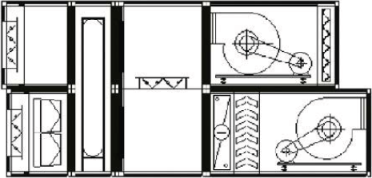
System components
Air Handling Units with DX coil
Regulating shutters
Mixing chamber
Return air fan
Double air stream (supply and return):
Cooling and heating use
Heat reclaim system (eg heat wheel):
Recommended for efficiency
Recommended due on-coil temperature limits in heating operation
Free cooling possible
Supply air fan
Filters
Heat wheel
DX coil
Drops eliminator
DX coil for cooling/heating
On-coil temperature is the
temperature of the air when
entering the DX-coil (R410A
heat exchanger)
Notes:
Air handling units are including primarily a filter section, a cooling or heating section and a fan section. In addition to these sections, other air treatment processes can be obtained by using heat recovery elements, mixing chambers, humidification devices. In our particular case, we use a direct expansion coil for cooling and heating of fresh air. As condensate occurs during cooling operation, a drop eliminator is required after the coil. The on-coil temperature is the temperature of the air when entering the DX coil and has to be within the allowed operation range. Too cold air or too warm air entering towards the coil can produce negative effects on the VRV operation and delivered comfort. Measures like mixing of fresh air with the return air or using a heat recovery element can safeguard the operation range. Finally, all the air treatment processes have to be controlled by sensors and control devices.

Slide 13
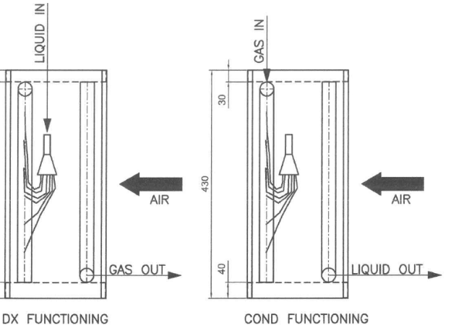

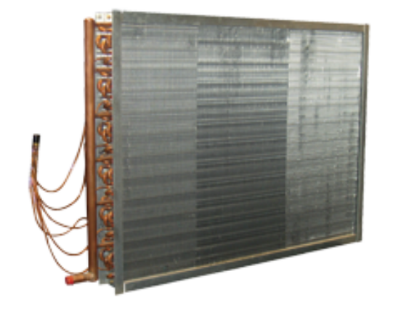

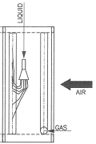
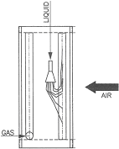

System components
DX-coil (R410A heat exchanger) requirements
The heat exchanger (HEX) of the AHU must be 2-connection type, designed for a pressure of 40 bar:
The liquid distributor on the HEX should be able to work with bi-directional flow.
The air approaches the gas side of the HEX first, the liquid side being “at the exit”:
Notes:
The most difficult component to be manufactured correctly is the DX coil. As many of the Air Handling Units are supplied by Daikin installers from by third party manufacturers, certain quality standards have to be checked. For example, verify with the DX coil supplier that the liquid distributor on this heat exchanger can work with bi-directional flow. There are certain types of “Venturi” distributors that have a very high pressure drop when the liquid flows in the opposite direction (in heating mode). CLICK The position of the DX coil should facilitate the approach of the air first to the gas side of the heat exchanger before arriving to the liquid side. CLICK

Slide 14
Selection & design
Operation range
 |  |  | Ambient temperature
 |  |  | Cooling | Heating
Entering air temp on AHU DX coil (on coil temperature) |  | Min | 14°C WB | 10°C DB
 |  | Max | 25°C WB / 35°C DB | 27°C DB
Outdoor unit | ERQ 1 phase ERQ 3 phase | Min | -5°C DB | -20°C WB
 |  | Max | 43°C DB | 15,5°C WB
 | VRV IV (air cooled) | Min | -5°C DB | -20°C WB
 |  | Max | 43°C DB | 15,5°C WB
 | VRV W IV (water cooled) | Min | 10°C DB (water)
 |  | Max | 45°C DB (water)
Expansion valve kit | Min | -20°C WB
 | Max | 46°C DB
Control box | Min | -10°C WB
 | Max | 40°C DB
Notes:
The operation range of the on-coil temperaturec is described here: during cooling operation, the maximum allowed temperature is 35°C while in heating operation the minimum allowed temperature is 10°C.In cold regions, in order to ensure that on-coil temperature is kept between these limits during heating operation, several measures are possible like for example the use of a pre-heater, mixing of the cold fresh air with the warm returning air, using a heat recovery element. C
In hot climate, pre-cooling by heat wheel or mixing chamber should be used. CLICK
The operation range of the outdoor units is the usual one for VRV. CLICK
Expansion valve kit and control box can be mounted outside within the mentioned limitations, howvever not in the direct sunlight. CLICK

Slide 15
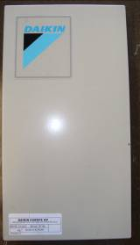
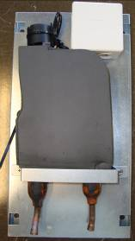
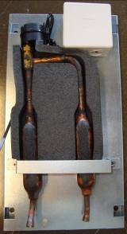
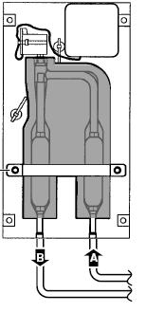
System components
Expansion valve kit EKEXV
Expansion Valve
6 Pin connection to control box.
Inlet
Outlet
Refrigerant filters integrated before and after the valve
Dimensions HxWxD: 401 x 215 x 78 mm
Vertical installation
Suitable for indoor or outdoor installation
Brazed connections
Notes:
The expansion valve kit is a simple device including the expansion valve and refrigerant filters installed before and after the valve.
The kit should be installed vertically.
For every expansion valve kit, a control kit EKEQ need to supplied as well.
The control kit will be explained later, within the control chapter. CLICK

Slide 16
Selection and Design
Calculation of the Fresh air Heat Load
DX coil calculation:
Capacity
SH ( Superheat)= 5K
SC (Subcool)=3K
Design pressure: min 40 bar
Pre-selection of the air handling unit including the DX coil
(based on required cooling/heating capacity)
Combination tables
Correction factors
Connection ratio limits
… all available in
VRV selection software
Selection of the EKEXV Kit
Selection of the Outdoor Unit
Re-check of the DX coil selection
(based on actual capacity)
Selection of the EKEQ*control box
Notes:
The logical steps to select a an air handling unit for connection to ERQ or VRV outdoor unit, are the following: CLICK
First comes the calculation of the required fresh air volume and of the corresponding cooling and heating capacity. This step is done by using the design input and the selection software provided by the AHU manufacturer. The calculation of the DX coil is based on capaicty, a superheat of 5K and a subcool of 3K. CLICK
After that, we need to do the selection of the EKEXV kit and the outdoor unit corresponding to the required capacity. Don’t forget to take in consideration the correction factors for piping length and defrost! This step can be realized by using for example the combination tables or the VRV Express. CLICK
Re-check of the DX-coil selection based on the actual capacity delivered by the outdoor unit and EKEXV kit
Finally also the control box has to be selected, depending on the required control pattern and the system configuration CLICK

Slide 17



Selection and Design
Piping and wiring length limitations
Outdoor unit to EKEXV kit |  | Max 50 m (ERQ) Max165 m (VRV)
EKEXV kit to AHU coil |  | 5 m actual
Outdoor unit – control box communication |  | 100 m (ERQ) 1000 m (VRV)
EKEXV connection and thermistor wiring |  | 20 m (ERQ) 50 m (VRV)
Level difference between outdoor and EKEXV kit | H_{OE} | +35 / -35 m (1~ ERQ model)
 |  | +30 / -30 m (3~ ERQ model)
 |  | +40 / -40 m (VRV IV)
Level difference between EKEXV kit and AHU coil | H_{EA} | +5 / -5 m
H_{OE}
H_{EA}
Notes:
The piping and wiring length limitations are different between ERQ and VRV IV. Please pay attention!
The expansion valve kit EKEXV must be placed as close to the AHU as possible -max. 5m-in order to avoid expansion of the refrigerant in the piping before the heat exchanger. CLICK

Slide 18
3
DX-AHU
Control
4 control alternatives
Control boxes
“X control”:
“Y control”:
“Z control”
“W control”
Notes:
In this chapter we will explore more in detail the 4 control patterns which are possible when combining ERQ and VRV4 with air handling units using DX coils. CLICK

Slide 19
Control Range of AHU in combination with ERQ/VRV IV: 4 alternatives
X: Control of air Temperature (Td, Ts or Tr- all field supplied sensors)
with external controller (DDC) using an un-proportional 0~10 V algorithm for capacity control
Y: Control of evaporating/condensing Temperature (Te- Daikin supplied)
with 3rd party thermostat and Daikin controller BRC1D52 or BRC1E52A/B used for field settings and error indication
Z: Control of air temperature (Ts or Tr- Daikin or field supplied sensors)
with Daikin controller BRC1D52 or BRC1E52A/B used for control, field settings and error indication
W: Control of air Temperature (Td, Ts or Tr- all field supplied sensors)
with external controller (DDC) using a proportional 0~10 V algorithm for capacity control
NEW IN 2015
AHU
Te
Te: evaporator temperature sensor
Ts: return air temperature sensor
Td: discharge (supply) air temperature sensor
Tr: room temperature sensor
Ts
Td
Tr
DDC
ROOM
12/1/2015
Notes:
The different control loops are getting the input from different air sensors like the return air temperature sensor, the discharge air temperature sensor, the room air temperature sensor and the evaporator temperature sensor. Based on these values, there are 4 types of control patterns possible: CLICK
In case of X control, the room air temperature is controlled in function of the discharge or return air temperature CLICK
In case of Y control, the room air temperature is indirectly controlled by setting a fixed evaporating temperature between 5 and 12°C. CLICK
In case of Z type, the control is similar to any VRV indoor unit, in function of the return air temperature. CLICK
Finally, the new W control is similar to the X control where the room air temperature is controlled in function of the discharge or suction air temperature. The difference between X and W consists in the method used for controlling the capacity by using a reference voltage 0~10V. This reference voltage is transferred to the Daikin control box and further used as the main input for the compressor. W control uses a proportional 0~10 V signal, meaning that delivered cooling capacity increases proportionally with the voltage value. X control uses a different logic which is not proportional, but the capacity control is more precise. CLICK

Slide 20
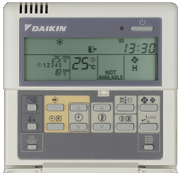
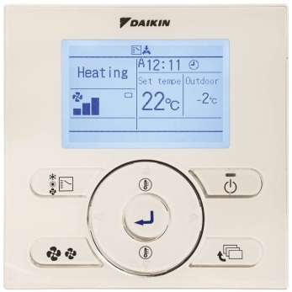
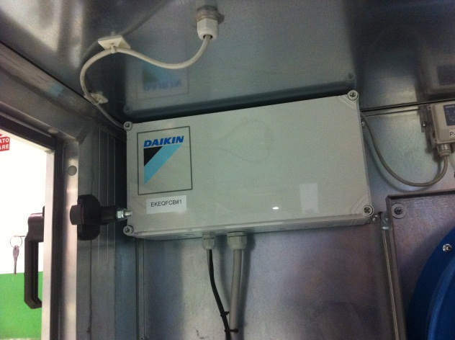
Daikin control box for “X-control”, “Y-control” & “W-control”
EKEQFCBA (indoor installation)
  Settings are done by Daikin wired remote controller:
Installation of EKEQ* control accessory within Daikin AHU
BRC1D52
BRC1E52A/B
Possible operations:
On/Off control
Error indication by flashing operation LED
Error code read-out on display
No set-point is indicated on the screen!
The remote controller is only needed for configurations (field settings) – not for direct input by end user. It should be accessible only to qualified technicians.
Notes:
EKEQFCBA si the control box used for X-Y-W control. In case of X and W control, the room temperature control is done by using a Direct Digital Controller also known as DDC. In case of Y control, the room temperature can be controlled indirectly, using a room thermostat. The Daikin wired remote controllers can be used for initial settings and for error indication. Settting the temperature is not possible by Daikin remote controller, only On/Off operation can be done. CLICK

Slide 21
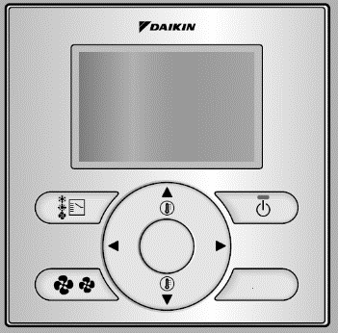

Daikin control box for “Z-control”
EKEQDCB (indoor installation) for “pair” combination with ERQ
EKEQMCBA (indoor installation) for “multi” combination with VRV IV
  Settings and control are done by Daikin wired remote controller:
Simplified controller
BRC1D52
BRC1E52A/B
BRC2E52C
Possible operations:
On/Off control
Operation mode (cooling/heating) control
Return / room air temperature Set-point control
Error indication by flashing operation LED
Error code read-out on display
BRC1E51A only: display of current return / room air temperature
BRC3E52C
A remote controller is always necessary in case the KRP4A51 optional accessory is used for remote on/off control.
Notes:
Z control can be achieved by using 2 different types of control boxes, depending on outdoor unit. For combination with ERQ, EKEQDCB should be used. For combination with VRV IV, only multi combination is allowed for Z control by using EKEQMCBA control box. By multi combination we understand that the VRV system is connected to multiple indoor units and AHU kits. With Z control, Daikin wired remote controlllers can be used for temperature control, like for any VRV indoor units. No external DDC controller should be connected. CLICK

Slide 22
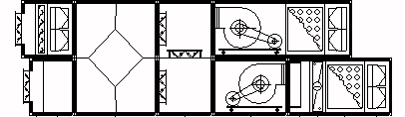
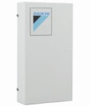
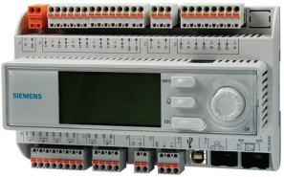
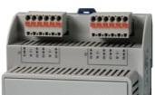

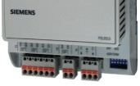
“X-Control” for Daikin AHU (in pair combination)
Supply/Return air control by an external DDC via a 0~10V DC signal
Tight control of air temperature via Daikin dedicated logic:
The DDC has to be programmed for “X control” pattern
the cooling (heating) capacity does not increase proportionally with the voltage signal.
“off the shelf “ DDC cannot be used without special re-programming
Fresh air
Return air
Exhaust
  Supply
T
EKEXV
On/Off signal
or
0~10VDC signal
EKEQFCBA
F₁F₂
BRC1D52
Needed only for set-up
VRV IV
ERQ
Siemens Microtech III
DDC controls the AHU functions + control the evaporation/condensation temperature
Notes:
We would like to give you more details about the” X-control”, let’s have a look on this scheme where the VRV outdoor unit or the ERQ are connected with a DX coil in pair combination. You can notice the expansion valve kit EKEXV together with the control box EKEQFCBA. The Daikin remote controller it is used only for initial settings. The supply air temperature control is done via a DDC and a temperature sensor T.
DDC controllers have to be programmed for X control pattern. Simply using any DDC controller “off the shelf” is not possible. As mentioned earlier, X pattern provides a tight control of delivered capacity and air temperature. The DDC can control many other functions of the air handling units which are linked to air quality, humidity and temperature. CLICK

Slide 23
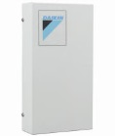
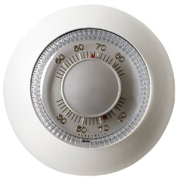

“Y-Control” (in pair combination)
Supply/Return air (indirect) control by fixing the evaporating/condensing temperature
The external switching thermostat (3rd party) will turn off the unit if it is cold (or warm) enough.
Fresh air
Return air
Exhaust
Supply
EKEXV
On/Off signal
or
EKEQFCBA
F₁F₂
VRV IV
ERQ
BRC1D52
Needed only for set-up
3rd party thermostat or other on/off control
The values of Te and Tc are fixed by field setting on remote controller:
A fixed target evaporating temperatures Te can be set between 5°C ~ 12°C (8°C is the factory setting)
A fixed target condensing temperature Tc can be set between 43°C ~ 49°C (46°C is the factory setting)
Notes:
In case of “Y control”, the target refrigerant temperature which is either the evaporating (Te) or the condensing (Tc), can be fixed and re-set at any time, while the room temperature is indirectly controlled.
A fixed target evaporating temperature between 5 and 12°C can be set by remote controller. The evaporating temperature determines the cooling load of the heat exchanger which can be supplied to the room.
In this example, a 3rd party thermostat can start of stop the air handling unit in order to control the room temperature. CLICK

Slide 24
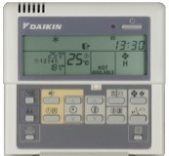
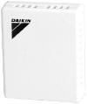
“Z-Control” (in pair combination with ERQ, max. capacity 28 kW)
Return air / Room temperature control using:
Daikin wired remote controller
Field supplied thermistor (R1T) or optional Daikin thermistor (KRC S01-1)
Similar control to the one of a VRV duct indoor unit
Fresh air
Return air
R1T
Field supplied air thermistor
Exhaust
Supply
or
EKEXV
EKEQDCB
F₁F₂
BRC1D52
REQUIRED accessory
KRCS01-1
Remote temperature sensor
Optional accessory
ERQ
With “Z”, no specific Supply air temperature control can be guaranteed!
Notes:
“Z control” is similar to a VRV unit control, using a Daikin controller. In this example, the set point can be decided on the BRC1D51 and the input is given by an air sensor which can be located on the return air duct or in the room. In case of room air sensor, we may consider to use a Daikin remote temperature sensor type KRCS01-1. For Z control, DDC is not required. Remote ON/OFF can be achieved by an optional adapter KRP4A51. CLICK “Z control” should not be used if control of supply air temperature is required. CLICK

Slide 25
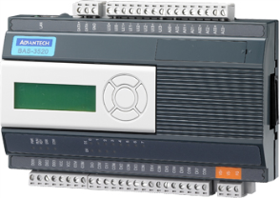
“W-Control” for Daikin AHU (in pair combination)
Supply/Return air control by an external DDC via a 0~10V DC signal
the cooling (heating) capacity increase proportionally with the voltage signal.
“off the shelf “ DDC can be used
Fresh air
Return air
Exhaust
  Supply
T
EKEXV
On/Off signal
or
0~10VDC signal
EKEQFCBA
F₁F₂
BRC1D52
Needed only for set-up
VRV IV
ERQ
3rd party “off the shelf” DDC
DDC controls the AHU functions + control the evaporation/condensation temperature
Notes:
W control was recently introduced to facilitate usage of third party DDC with any special reprogramming. Different to X control, in this case the DDC is translating the temperature difference between set point and air discharge temperarure in to a proportional 0~10 V signal which is further trannsferred to the Daikin control box EKEQFCBA. This voltage controls the compressor frequency. CLICK

Slide 26
4
DX-AHU
Multi application
Features & combinations
System layouts
Interlaced DX coil
Notes:
In the last chapter we will have a look on the Multi application of the Air Handling Units combined with VRV IV. By the introduction of the new expansion valves size 400 and 500, more possibilities appear. CLICK

Slide 27
Main features and benefits
Multi combination:
Possible to combine VRV indoor units and AHUnits within a VRV system
Possible to combine more AHUnits within a VRV system
Possible to reach capacities up to 150 kW (54HP) on one AHU coupled with a VRV IV outdoor unit
An AHU may include max. 3 expansion valve kits EKEXV
The connection ratio limitations and the way of controlling the air temperature are crucial for the selection of the correct combination:
Supply/Return air temperature control (X-Y-W)
Return air temperature control (Z)
VRV IV Heat pump:
up to 150 kW on one VRV system
1 outdoor+ several DX kits:
  VRV OU+ one AHU (with max 3 DX kits)
  VRV OU+ multiple AHUnits
connection ratio limitation: 90~110%
VRV IV Heat pump &
VRV IV Heat recovery:
up to 150 kW on one VRV system
  VRV OU+AHU+VRV IU
connection ratio limitation: 50~110%
where VRV IU ratio is min. 50%
Max 36 indoor units per system (an EKEXV kit is counted as one indoor unit)
Notes:
A multi combination is defined as a combination between one VRV outdoor unit and several indoor units which can be either exclusively AHU kits or a mix between VRV indoor units and AHU kits.
Due to the introduction of the new expansion valve kits size 400 and 500, we can reach cooling capacities of 150 kW on one air handling unit coupled with the biggest VRV outdoor unit size 54 HP.
We can achieve this by coupling maximum 3 expansion valve kits on one interlaced DX coil.
The connection ratio limitations and the control patterns are crucial for the selection of a correct combination. CLICK
To be noticed that maximum connection ration is limited to max 110%. CLICK One consequence is that maximum number of indoor units per VRV system is in this case 36.
Another point of attention is that all VRV IV outdoor units can be connected with air handling units, however when using the heat recovery series, only Z control is possible.
In the following slides we will explore some of the most typical multi configurations. CLICK

Slide 28
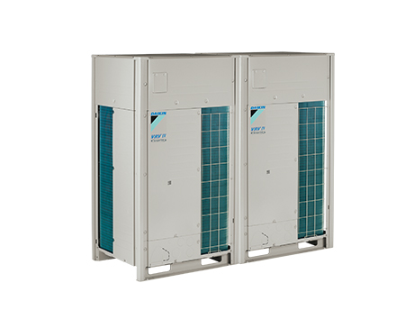

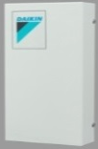
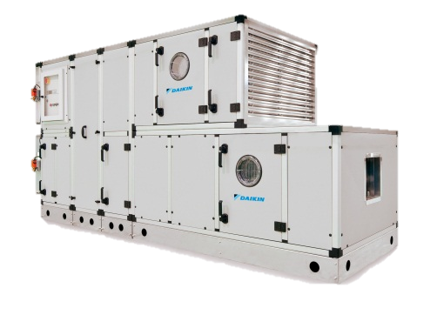
System layout 1:
VRV IV (H/P) up to 54HP (150 kW) combined exclusively with one A.H.U.
Max 3 DX kits/AHU
Interlaced coil with 3 circuits
Connection ratio between 90~110%
Control by DDC
Supply air (or return air)
temperature control (X, Y, W)
F₁F₂
F₁F₂
F₁F₂
VRV IV
8 ~ 54 HP
(only Heat Pump model)
EKEQFCBA
EKEQFCBA
EKEQFCBA
EKEXV class for multi combination with VRV
50 | 63 | 80 | 100 | 125 | 140 | 200 | 250
400 | 500 | NEW IN 2015!
In case of a DAIKIN AHU, everything is integrated. No need for additional equipment and installation
Interlaced DX coil (3 circuits)
Max 150 kW
Not possible to combine in same system AHU and hot water module
Notes:
In this layout we show a combination between a VRV IV heat pump and 3 Expansion valve kits which come together with their control boxes. The control box type used in this case for supply air temperature control is EKEQFCBA. Control of air temperature is done by a DDC. The 3 expansion valve kits are further linked to a DX coil having 3 interlaced circuits, one for each EV kit. CLICK Due to the introduction of the 400 and 500 expansion valve kit, there is now possible to connect a 54 HP outdoor unit to an air handling unit. The connection ratio has to fall between 90 and 110%. For a 54 HP system, that means that capacity index should be between 1215 and 1485.
By choosing 2 times an EKEXV500 and once an EKEXV400, the total capacity index is 1400, falling in the prescribed interval. Of course final calculation of the VRV system depends also on the correction factors for piping length which should not be neglected! CLICK

Slide 29
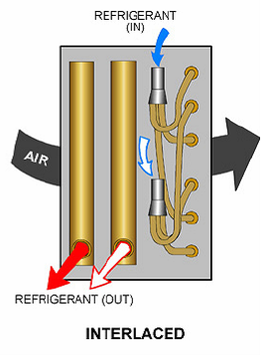
System layout 1:
Key component: the DX coil with interlaced circuiting
How to combine one VRV outdoor units with 2~3 DX kits in one AHU?
One or more coils are required?
How to secure an even distribution of capacity?
The most suitable solution is a DX coil with interlaced circuiting
Example: DX coil with 2 interlaced circuits
Every alternate pipe in the coil is included in first circuit and the other pipes are included in the second circuit.
The obvious advantage is that the air passes across the face of the coil and there are always pipes in operations.
In this example, the split of capacity is exactly 50/50.
Notes:
One of the toughest concepts to understand about the direct expansion coils is the so called “splitting” of the coil, so that 2 or more Expansion Valve kits units operate on the same coil, therefore on the same Air Handling Unit. There are 3 types of circuiting possible: the face control, the row control and interlaced. CLICK The most efficient in terms of load distribution and capacity control is the interlaced cicuiting.CLICK Every alternate pipe in the coil is included in the first circuit and the other pipes are included in the second circuit and so on. The circuits are “woven” among themselves with the adavantage that cooling or heating capacity are evenly distributed in the air flow. The downturn of interlaced circuiting is the practical difficulty to make it as a manufacturer. CLICK

Slide 30


System layout 2:
VRV IV up to 54HP (150 kW) combined (exclusively) with multiple A.H.Units
Connection ratio is limited between 90~110%
Max 3 DX kits/AHU
Control by iTM II
Return air temperature control (Z)
EKEQMCBA
VRV IV
8 ~ 54 HP
(only Heat pump model)
F₁F₂
F₁F₂
In case of a DAIKIN AHU, everything is integrated. No need for additional equipment and installation
EKEQMCBA
Not possible to combine in same system AHU and hot water module
Notes:
Another possible configuration is to combine several Air Handling Units with one VRV IV outdoor unit heat pump. In this case only return air control is possible and can be obtained by using dedicated control boxes for multi application, namely EKEQMCBA. The connection ratio is limited between 90 and 110%. Individual control by Daikin remote controller or centralised control by intelligent Touch Manager are possible, like for any VRV indoor unit. CLICK

Slide 31


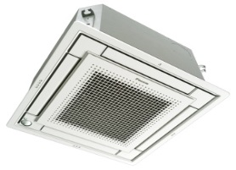
System layout 3:
VRV IV up to 54HP (150 kW) combined with VRV indoor units and A.H.Us
Conditions:
Max 3 DX kits/AHU
Connection ratio between 50~110%
VRV indoors should be min 50% ratio
Control by iTM II / wired remote controllers
Return air temperature control (Z)
EKEQMCBA
VRV IV
8~54 HP
(Heat pump and Heat recovery)
F₁F₂
F₁F₂
F₁F₂
F₁F₂
In case of a DAIKIN AHU, everything is integrated. No need for additional equipment and installation
Not possible to combine in same system AHU and hot water module
Notes:
The third category of multi application includes combination of a mix of VRV indoor units and air handling units to one VRV outdoor unit. This combination offers a total solution by one VRV system, including cooling, heating and fresh air. CLICK It is NOT possible to combine also a hot water module in the same system. All VRV outdoor units, Heat Pump or Heat Recovery can be used for this layout. This configuration is allowing only Z control, meaning control of return air temperature, similar to any VRV indoor unit. Connection ratio is limited bteween 50 and 110% and the VRV indoor units should represent min 50%. Control of both VRV units and air handling units can be done by individual remote controllers or iTM II.

Slide 32
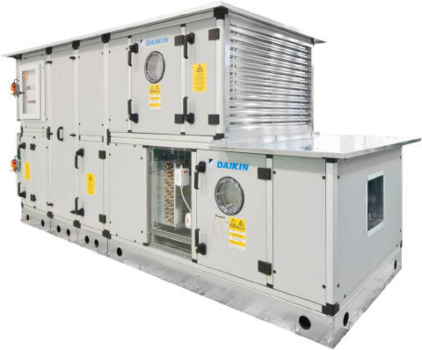
I-Touch Manager II control of Air Handling Units
Types:
  Daikin Air Handling Units with control boxes (EKEQFCBA, EKEQDCB, EKEQMCBA)
  McQuay A.H.Units with Microtech III controller including BACnet module
Examples of control possibilities:
  ON/OFF
  Operation mode (cooling/heating)
  Setpoint (in case of Daikin AHU, only for “Z” control)
  Error indication
  PPD (only for Daikin AHU)
  ….
End user benefits:
  Single control point
  Energy saving ( free cooling interlock, schedules…)
  Enhanced comfort
  Price competitive mini BMS
Benefits:
Notes:
For now we can say that I-Touch Manager II provides total solution thanks to the integration of the air handling units with the different control boxes via the F1F2 wiring. Various controls are possible like for example changing the operation mode, display of error codes, making schedules and interlocking with other units. Setpoint fixing is possible only for the so called “Z” control. In this case also the power proportional division function is available to quantify the energy consumption. iTM II can also control the air handling unit via the BACnet protocol, provided that the DDC controller includes a BACnet module to “speak” this language. [CLICK]
The end-user will enjoy a single point of control for the whole installation that will allow him to save energy thanks to some features like free-cooling, schedules.
Moreover the comfort is enhanced thanks to the smart integration of different systems that will work together instead of working against each other.
[CLICK]

Slide 33
Selection and Design
Piping and wiring length limitations
Outdoor unit to EKEXV kit |  | 165 m actual max.
EKEXV kit to AHU coil |  | 5 m actual max
Outdoor unit – control box communication |  | 1000 m
EKEXV connection and thermistor wiring |  | 50 m
Level difference between outdoor and EKEXV kit | H_{OE} | +40 / -40 m (VRV IV)
Level difference between EKEXV kit and AHU coil | H_{EA} | Max 5 m
Level difference between 2 EKEXV kits | H_{EE} | Max 15 m
VRV IV
H_{OE}
H_{EA}
H_{EE}
Notes:
Next to the connection ratio limitations, another critera to take in consideration are the piping & wiring limitations. An important point of attention is the distance between the EKEXV kit and air handling unit which should be maximum 5m. CLICK

Slide 34
5
DX-AHU
Review
Combinations
Sales arguments
Notes:
And now, let’s have a review of the possible combinations between ERQ and VRV IV with Air Handling Units, trying to summarize the sales arguments.

Slide 35

Daikin condensing units ERQ / VRV IV + AHU
Review of combinations
DX coil + ERQ outdoor unit
DX coils + VRV IV outdoor unit
Supply/return air temperature control
(X-Y-W) by DDC
or
Return air temperature control (Z)
by wired remote controller
Supply/return air temperature control
(X-Y-W) by DDC
Return air temperature control
(Z) by iTM II
ERQ (up to 25 kW)
Pair combination (1 outdoor+ 1 DX kit)
Heat pump
VRV IV Heat pump:
Pair combination: (up to 60 kW )
1 Outdoor+1 DX kit
Multi combination : (up to 150 kW)
1 Outdoor+1 AHU (max 3 DX kits)
VRV IV Heat pump: Multi combination (up to 150 kW)
  1 Outdoor + AHU + VRV IU 1 Outdoor + AHU + AHU
VRV IV Heat recovery: Multi combination (up to 150 kW )
  1 Outdoor+ AHU+VRV IU
Not possible to combine in same VRV system both AHU and hot water module
Notes:
The possible scenarios are summarized here for both pair an multi combinations. In pair combinations, both ERQ and VRV IV outdoor units can be used. For multi combination, only VRV IV outdoor units can be used. VRV IV heat recovery should be always combined with a mix of VRV indoor units and Air Handling Units. VRV IV heat pump can be combined also exclusively with Air Handling Units. The control of the Air Handling Unit depends on the control pattern which is used. For X and W control, a DDC is required. Z control is similar to VRV indoor unit control so wired remote controllers or an iTM should be used. Y control is the most basic one, done only by ON-OFF operation via a room thermostat. X control is used for precise capacity control and requires a special re-programming of the DDC. This re-programming is not needed for W control. CLICK

Slide 36
Sales arguments review
An “Air Handling Unit” is needed:
  whenever the required Airflow/ESP is bigger than those delivered by VAM and VKM
  whenever special treatment of air is required (eg humidity control, special filters)
Daikin AHU is plug and play, including:
  DX coil, simple or with interlaced circuiting
  Expansion valve kit and Control box for ERQ/VRV IV connection
  DDC controller for “X” or “W” control
ERQ: cost efficient solution, for up to 10HP
VRV IV heat pump outdoor unit (up to 54HP):
  Can combine exclusively with Air Handling Units
  Can combine with a mix of VRV indoor units and Air Handling Units
VRV IV heat recovery outdoor unit (up to 54HP):
  Can combine with a mix of VRV indoor units and Air Handling Units
VRV IV with continuous heating during defrost means no draft feeling
Notes:
Why do we need to develop and learn about these combinations with of VRV with Air Handling Units? Air Handling Units are the traditional products for air conditioning, largely used in combination with chiller systems. Highly customizable, and AHU provides an accurate air treatment and trasnportation.
In this sense, the VAM and VKM units suffer a handicap, mainly due to reduced airflow and external static pressure. In order to enlarge the VRV appllication, we have to be able to offer more alternatives for fresh air handling. An Air Handling Units with DX coil combined with VRV is reacting quickly to the demand and requires a simple integration. CLICK Daikin Air Handling Units can be plug&play, being delivered with the necessary components and control sytem in order to combine fast with ERQ or VRV IV outdoor. CLICK ERQ is a cost efficient solution for capacities up to 10 HP. CLICK VRV IV brings more capacity, up to 54 HP together with other advantages linked to continuous heating during defrost or usage of iTM.

