Slide 1
Control Accessories

Slide 2
Control Accessory- G-Way
Specification
Remote control (ON/OFF) of FCU via BMS.
Unit error indication via BMS and wired control panel .
Unit operation status monitoring via BMS.
Maximum point to point communication bus up to 1000m.
DIP switch setting for control or monitoring function.
User retains the ability to control the other settings.
(MODE, FAN SPEED, AIR SWING, TIMER, SET TEMPERATURE etc).

Slide 3
Control Accessory- G-Way
Specification
The G-way system consists of :
  Main Board controller (U1.4 / W1V3 / L208A / U1SB125)
  Display control panel (wired / wireless controller)
  G-way controller

Slide 4
Control Accessory- G-Way
Specification
  Connection diagram
Relay rating:
30VDC, 3A
250VAC, 2A
To Wired Control Panel
Dry Contact
Input
Dry Contact Switch
CN2
NC
CN1
RELAY1
RELAY2
NO
Dry Contact Output 1
Unit On/Off Indicator
COM
To Main Board
NC
NO
Dry Contact Output 2
Unit Error Indicator
COM
Dip Switch
Terminal Blocks
G-way Controller
960m
BMS
Notes:
Where is the 12V comes from? (to energize the Relay)

Slide 5
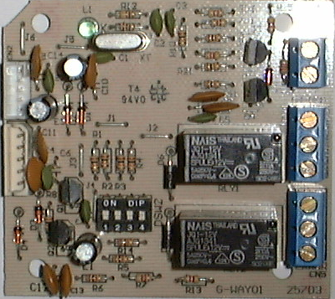
Control Accessory- G-Way
Specification
  Hardware configuration
DSW2
Types of Operation | DSW2 Setting
Control & Monitor (Ext. Switch Closed = ON A/C) | 0000
Control & Monitor (Ext. Switch Open = ON A/C) | 0010
Monitoring only | 0001

Slide 6
Control Accessory- G-Way
Specification
  Hardware configuration
When DSW2 is set to 0000 or 0010, FCU can only be ON/OFF via BMS. No display control panel/handset will be able to ON/OFF the FCU. However when FCU is ON, FCU parameters are set-able using display control panel/handset.
When DSW2 is set to 0001, FCU can be ON/OFF using display control panel/handset and BMS cannot ON/OFF the unit. However all three settings allow for monitoring of the alarm or operation status of the FCU (ON/OFF)

Slide 7
Thank you

