Slide 1

Controles
Notes:
From that introduction, let’s go further into the system feature.

Slide 2
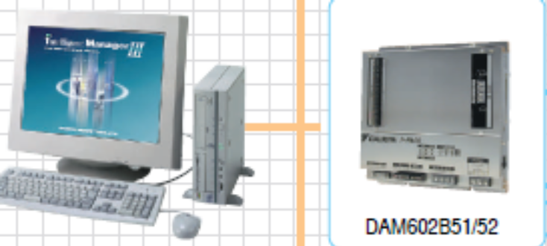
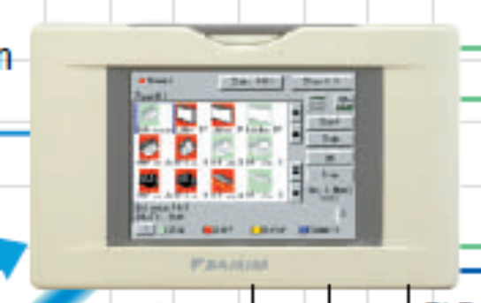
Avanzado sistema de Control Integrado
DCM601A51 – ITouch Manager
Notes:
To close my speech, I will introduce control system for VRVIII.

Slide 3

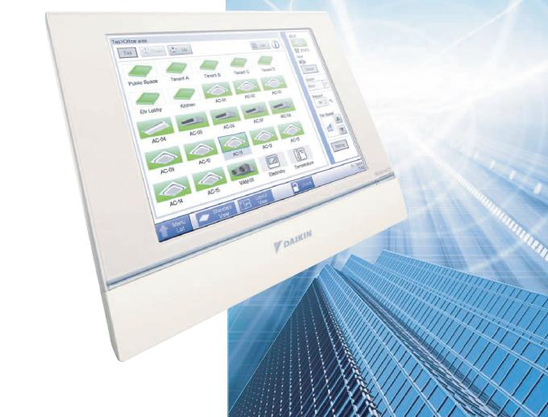
Monitoreo
Control
Gerenciamiento
Todo en uno
SIstema de gerenciamiento de aire acondicionado para edificios

Slide 4
DⅢ-NET diseño
RXY10
RXY10
RXY10
RXY10
RXY10
RXY10
RXY10
RXY10
iTM
Plus
ADP
iTM
1.Draw DⅢ-NET wiring line
2.Assign Port No(iTM Plus ADP)
3.Assign DⅢ-Address
4.Assign Management point name
5.Decide Area

Slide 5
Frente
Backup battery switch
LAN port switch(Front/Back)
Status LED
Monitor switch
Reset switch
USB flash drive port
DⅢ Master/Slave switch
(Same function as Master Connector)
LAN port(Front)
(for maintenance)

Slide 6
LED Status
LED |  | Note
H | MONITOR | The green/orange LED lights while iTM is powered ON.
E | CPU ALIVE | The green LED indicates system status.
F | LAN LINK | The green LED lights when the LAN port is linked.
G | DⅢ MONITOR | The yellow LED blinks while data is being sent or received on DIII-NET.
LED
iTM Status |  | LED Status
Power ON | Back light ON | ON(Green)
 | Back light OFF | ON(Orange)
Power OFF |  | OFF
iTM Status |  | LED Status
Normal |  | BLINK(0.4sec interval)
Malfunction | Hardware | OFF
 | Software | ON

Slide 7
Contra Frente
internal modem
DⅢ(F1,F2）
RS-485
(External I/O)
Euro: 100-240V AC
North America: 24V AC
iTM Plus Adaptor
Di/Pi
LAN port(Back)

Slide 8
②iTM Plus Adaptor
(Global model :DCM601A52, US model :DCM601A72)
Input/Output port
Port | Number | Use
plus ADP IF | 1ch | iTM Plus Adaptor（Up to 7 Adaptors）
DⅢ | 1ch | DⅢ-NET(Up to 64 groups)
Di(Pi) | 4ch | Emergency stop input, Pulse input,Contact signal input

Slide 9
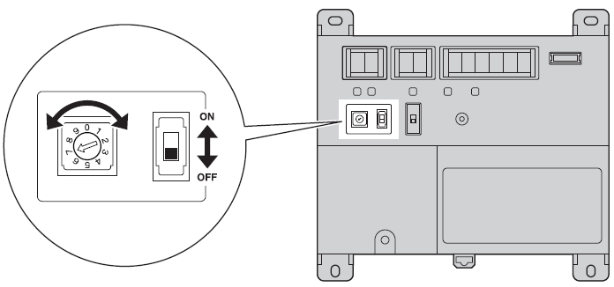
iTM Plus Adaptor
iTM Plus Adaptor
DⅢ（F1,F2）
Di/Pi
Termination switch
RESET
switch
DⅢ-NET port number
(use 2 to 8)
Master/Slave switch
(Same function as Master Connector)

Slide 10
Cableado iTM + iTM Plus Adaptor
[Wiring]
Be sure to connect the positive wire to the “+” terminal and the negative wire to the “–” terminal.
Termination switch of the furthest iTM Plus Adaptor from the iTM must be ON.
(Termination switch of the other iTM Plus Adaptor must be OFF.)
Cable
Cable type | CPEV or FCPEV cable
Core thickness | φ0.65 - 0.9 mm
Cable length | 50 meters or less in total for overall plus ADP IF wiring
Up to 7 iTM Plus Adaptors can be daisy-chained on the system at once.

Slide 11

Compatibilidad controles con iTM
Available controller with iTM
Controller |  | Installation with iTM | Remark
BACnet Interface | DMS502B51 |  | R/C Restriction can not be used on iTM.
LON Interface | DMS504B51
Central Remote Controller | DCS302CA61 |  | D3Dio,D3Di can not be used. DⅢaddresses５-00～8-15 can not be used.
Unified ON/OFF Controller | DCS301BA61 |  | D3Dio,D3Di can not be used. DⅢaddresses 5-00～8-15 can not be used.
iManager | DAM602B51 | Can NOT install with iTM on same DⅢ-NET | Functions are conflicted, because these controllers have same functions as iTM like an automatic control.
iTouch Controller | DCS601C51
Residential Central Remote Controller | DCS303A51
Schedule Timer | DST301BA61 |  | Error code MA will be shown.
Notes:
従での機能制限機能について(D3に2台つける場合に従に設定)

Slide 12
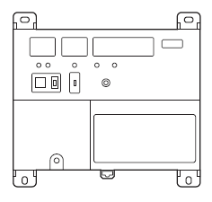

Master/Slave Setting
iTM must be the Slave if there are BACnet,LON interface.
■BACnet interface
（DMS502B51）
or
■LON interface
（DMS504B51）
DⅢ-NET
■BACnet interface
（DMS502B51）
or
■LON interface
（DMS504B51）
DⅢ-NET
iTM
iTM Plus Adaptor
Master
Master
Slave
Slave
Central Remote Controller and ON/OFF Controller must be the Slave
if there are iTM
DⅢ-NET
iTM Plus Adaptor
DⅢ-NET
iTM
■Central Remote Controller
（DCS302CA61）
or
■Unified ON/OFF Controller
（DCS301BA61）
■Central Remote Controller
（DCS302CA61）
or
■Unified ON/OFF Controller
（DCS301BA61）
Master
Slave
Slave
Master
remove the master connector
from DCS302CA61, DCS301BA61

Slide 13
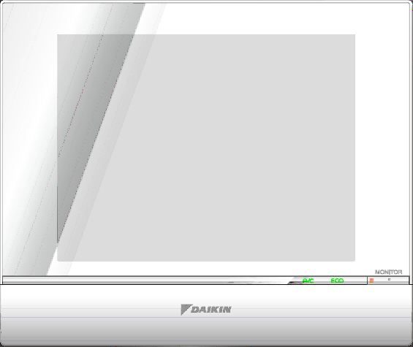
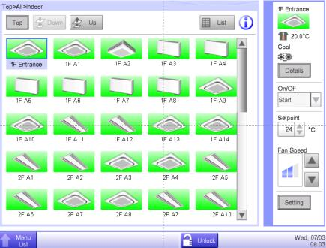
Sistemas de Control Inteligente Compacto
Control de 512 IU por Controlador
Compacto, todo en uno
Pantalla táctil color
Control automático de VRV
Fácil aplicación para gerenciamiento de edificios
290mm
243mm

Slide 14
3 pasos para control y gerenciamiento
En cada oficina
1.Control local
Uso amigable-control integrado para el
gerenciamiento del sistema
2. Monitoreo remoto
Cobertura de todos los edificios de diferentes lugares a través de Internet
En su centro de control
Por Instalador / por Daikin
3. Mantenimiento preventivo
Monitoreo diario, permite predicción de fallas para el mantenimiento preventivo

Slide 15

Gerenciamiento Local

Slide 16
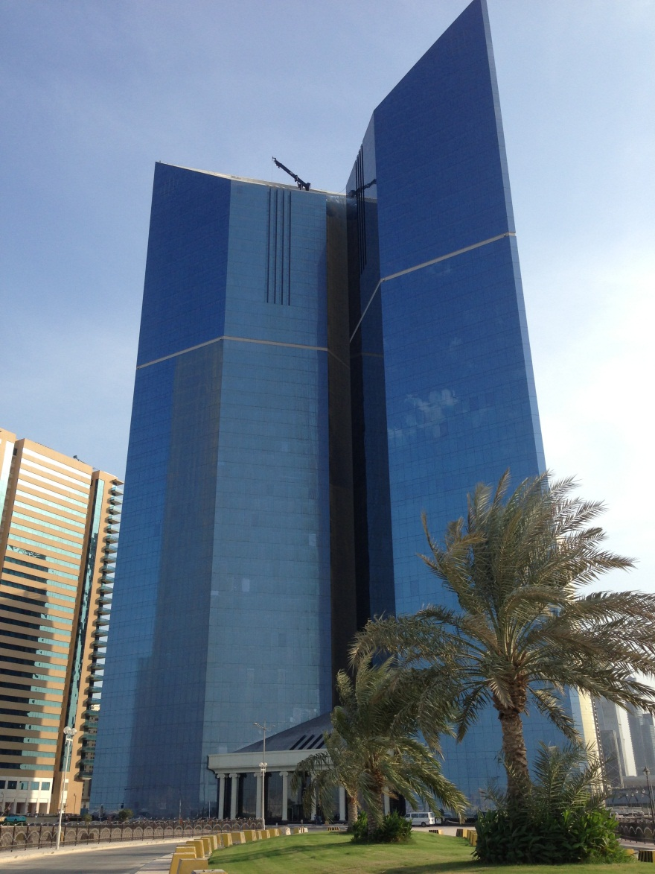

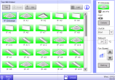
Administracion de Grandes sistemas VRV
Varios TMs integrados via Web on a PC
1 iTM manager / edificio

Slide 17

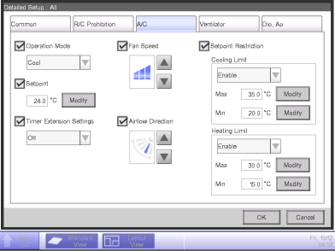
Fácil Operación
Detalles información
On/Off operación
Setpoint cambio
Otras operaciones
Ventilaciónvolumen
cambio

Slide 18
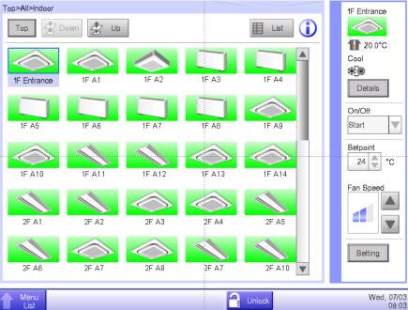
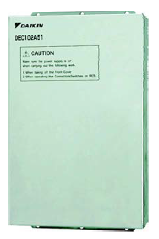


Manejo de otros sistemas del Edificio
Utilizando DTA / DEC
DIII net
Di/Do/Ai
bomba
Vent 2
Vent 1
Instalaciones del edificio

Slide 19
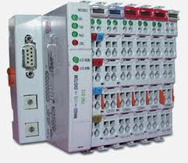



Manejo de Otros Sistemas del Edificio
Utilizando interfaces WAGO I/O system
RS485
Di/Do/Ai
Pump
Motion sensor
CO₂ sensor
FAN
Temperature
Servicios del Edificio

Slide 20
Tipos de “Puntos de Gestion” disponibles
Management point type | function | Remarks
External Di | On/Off monitoring | Contact type: A type(*1)/B type(*2). Also can be used as the emergency stop input signal.
 | Error monitoring | Contact type: A type(*1)/B type(*2).
External Dio | On/Off monitoring | Contact type: A type(*1)/B type(*2). Also can be used as the emergency stop input signal.
 | Error monitoring | Contact type: A type(*1)/B type(*2).
 | On/Off control (output) | Contact type: A type(*1)/B type(*2). Constant/instantaneous contact.
External Ai | Analog value monitoring | Upper and Lower limits error monitoring.
External Ao | Analog value control (output) | Upper and Lower limit for operation.
External Pi | Pulse monitoring | Not available for PPD.
(*1)A type:Normally Open Contact
(*2)B type:Normally Close Contact

Slide 21
Esquema del sistema
MAX total length
500m
MAX 30 WAGO nodes
connector
connector
WAGO
Node
WAGO
Node
Cable:see WAGO manual
MAX 120 devices (contacts) per one WAGO Node
Cable
Cable type | CPEV or FCPEV cable
Core thickness | φ0.65 - 0.9mm

Slide 22
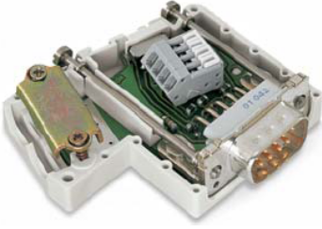
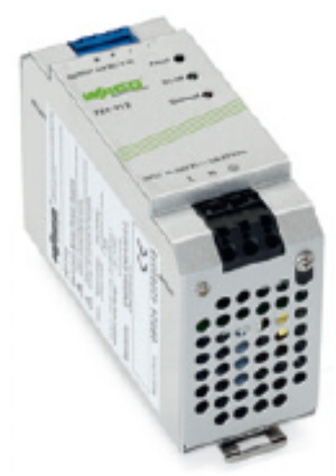
Esquema del sistema WAGO
Connector(Model:750-960)
Power Supply Unit
(Model:787-712)
1
2
3
1. BUS Coupler
(Model:750-315/000-002/K190-6442)
2. I/O modules(Di,Do,Ai,Ao,Pi)
Up to 120 contacts
* not the number of modules
3. End module
(Model:750-600)

Slide 23
Modulos básicos WAGO
 | Module | Spec | Model
Required Module | 24V DC Power Supply Unit | IN:100V/240V AC OUT: 24V DC, 2.5 A | 787-712
 | BUS Coupler | Modbus(RS-485） 115.2kbps | 750-315/000-002/K190-6442 (customized unit for DAIKIN)
 | Connector | － | 750-960
 | End module | － | 750-600
Option Module | 24V DC Power Supply module | IN：24V DC OUT:5V DC | 750-613

Slide 24
Modulos WAGO I/O
Module Type |  | The Number of contacts | Specifications | Model
Di |  | 2 contacts | No-voltage contact input Contact rating:24V DC/4.5mA | 750-400
 |  | 4 contacts |  | 750-432
 |  | 8 contacts | No-voltage contact input Contact rating: 24V DC/2.8mA | 750-430
Do |  | 2 contacts | No-voltage contact output Contact rating:230V AC/30V DC,2A | 750-513/000-001
 |  | 4 contacts | No-voltage contact output Contact rating; 24V DC, 0.5A | 750-504
Ai | mA | 2 contacts | Analog Input:4-20 mA | 750-454
 |  | 4 contacts |  | 750-455
 | V | 2 contacts | Analog Input: ±10 V | 750-479
 |  | 4 contacts | Analog Input: 0-10V | 750-459

Slide 25
Modulos WAGO I/O
Module Type | The Number of contacts | Specifications | Model
Ao | 2 contacts | Analog output: 4-20mA | 750-554
 | 4 contacts |  | 750-555
 | 2 contacts | Analog output: 0-10V | 750-560
 | 4 contacts |  | 750-559
Thermistor | 2 contacts | NTC20K thermistor | 750-461/020-000
 | 2 contacts | Pt 100/RTD | 750-461
 | 4 contacts |  | 750-460
 | 2 contacts | Pt 1000/RTD | 750-461/000-003
 | 4 contacts |  | 750-460/000-003
 | 2 contacts | Ni 100/RTD | 750-461/000-004
 | 2 contacts | Ni1000 TK6180/RTD | 750-461/000-005
 |  |  | 750-460/000-005
 | 4 contacts
Pi | 2 contacts | Minimum pulse width: 1ms | 750-638

Slide 26
Required I/O module for Management point
Management point type | Function | Required I/O module and the number of contacts
 |  | Di | Do | Ai | Ao | Pi
External Di | On/Off monitor | 1 contact
 | Error monitor | 1 contact(*)
External Dio (output: constant contact) | On/Off monitor | 1 contact(*)
 | Error monitor | 1 contact(*)
 | On/Off control |  | 1 contact
External Dio (output: instantaneous contact) | On/Off monitor | 1 contact(*)
 | Error monitor | 1 contact(*)
 | On output |  | 1 contact
 | Off output |  | 1 contact
External Ai | Analog monitor |  |  | 1 contact
External Ao | Analog output |  |  |  | 1 contact
External Pi |  |  |  |  |  | 1 contact
(*) : If the monitoring is not needed, these contacts are not required.

Slide 27
DC24V Power Supply module (750-613)
BUS Coupler needs 24VDC from Power Supply unit (787-712).
BUS Coupler can supply 5VDC up to 32 contacts.
DC24V Power Supply module(750-613) must be inserted at every 32 contacts.
DC5V
WAGO I/O modules
DC24V Power Supply
DC24V Power Supply
DC24V power supply module(750-613)
DC24V power supply module(750-613)
Max 32 contacts
*Not the number of modules
Max 32 contacts
*Not the number of modules

Slide 28
Di, Ao and Pi module require 24VDC.
Ai and Do don’t require 24VDC, and cannot pass DC24V to next module.
The DC24V power supply module(750-613) must be inserted if the Di or Ao module is located at the next to Ai,Do module.
Pi module cannot be mixed with other modules.
Di(2ch)
Di(4ch)
Ao(2ch)
Ao(2ch)
Do/Ai
Do/Ai
Do/Ai
Do/Ai
Do/Ai
Do/Ai
Do/Ai
Do/Ai
DC24V Power Supply
Di(2ch)
Di(2ch)
Do/Ai
Do/Ai
Do/Ai
Ai,Do module can not pass DC24V
DC24V power supply module(750-613)
is needed for Di module.

Slide 29

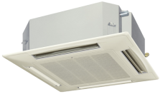
  INTERLOCKING CONTROL
  Hasta 500 programas
  No solo progrmas de arranque y apagado.
  -Interlocking con inputs ANALOGICOS ,Errores, cambiso de modo.
Key switch
On
start
Off
stop
Motion sensor
stop
Off during 10min
continuously

Slide 30
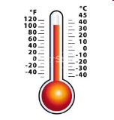
CO2 sensor
CO2 < 800ppm
during 30min continuously
Fan Speed
Low
Error
Error
start
Backup units
Temperature
<
18℃
Analog value
Additional heater units
Operation mode
during 30min continuously
start
Heating

Slide 31
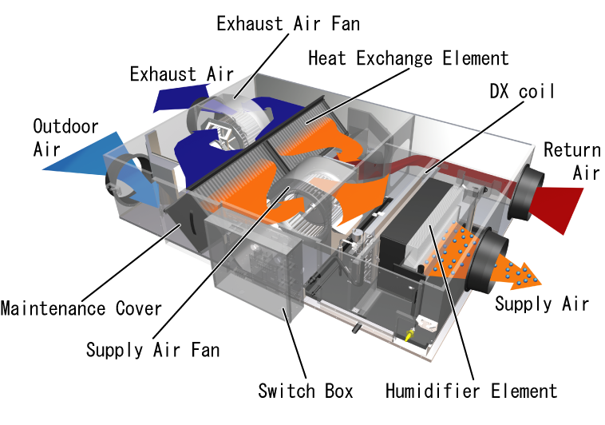
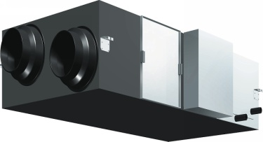
Cajas VAM /HRV

Slide 32

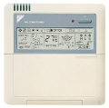
TIMER Extension
Stop indoor units automatically after selected duration.
Duration is selectable from 30, 60, 90, 120, 150, 180Min
ON
OFF
Timer Extension [On]
Duration
(30/60/90/120/150/180 min)
OFF
OFF
Timer Extension [On]
ON
Duration
(30/60/90/120/150/180 min)
User start indoor unit
(R/C,iTM,etc)

Slide 33

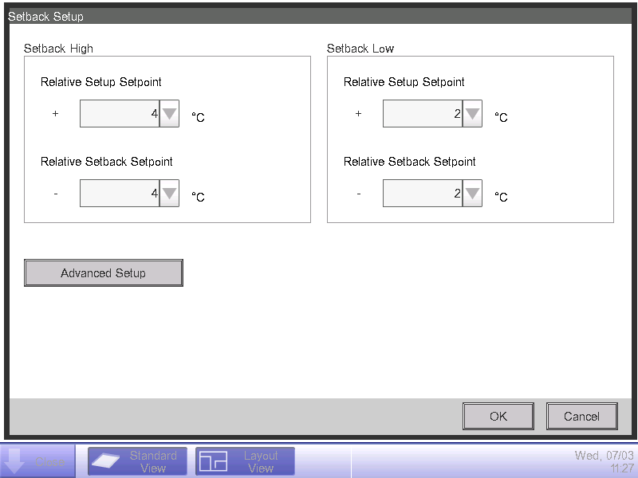
Funsion Setback High / Low
2 Types of Setback Control are available.
Cooling
Setback Low Control
Setback High Control
Lunch
Normal
Normal
Relative Setup Setpoint of Setback High Control
Cool setpoint
Cool setpoint
Relative Setup Setpoint of Setback Low Control
8:00
12:00
13:00
18:00
8:00

Slide 34
Setback Control by Interlocking Control
Key switch
On
Start(normal)
Off
Setback Low/High Start
Setback Control
On/Off to keep this temperature
Cool setpoint
Relative Setup Setpoint of Setback Low/High
Cool setpoint
26℃
Key switch Off
Key switch On

Slide 35
Monitoreo Operacion Remoto

Slide 36
Monitorieo Remoto (1)
Posibilita:
  Monitoreo Remoto de cada AC por Oficina
    Estado
    Señal de Mal funcionamiento
  Cambio de seteos en cada oficina
Beneficios:
  Monitoreo y control de cualquier equipo
  conectado a la red TCP/IP instantaneamente
  Posibilidad de gestion de service remoto

Slide 37
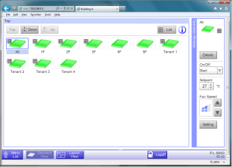

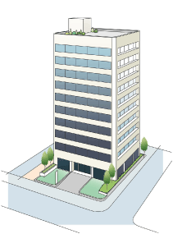


Control a Distancia
Monitoring & Operation
through Web function.
!
From: siteA
Subject: Fault occurs(Site A)
Head office
Internet
Error notification
Error
Site A
Site B
Site C

Slide 38
Mantenimiento / Service Remoto

Slide 39
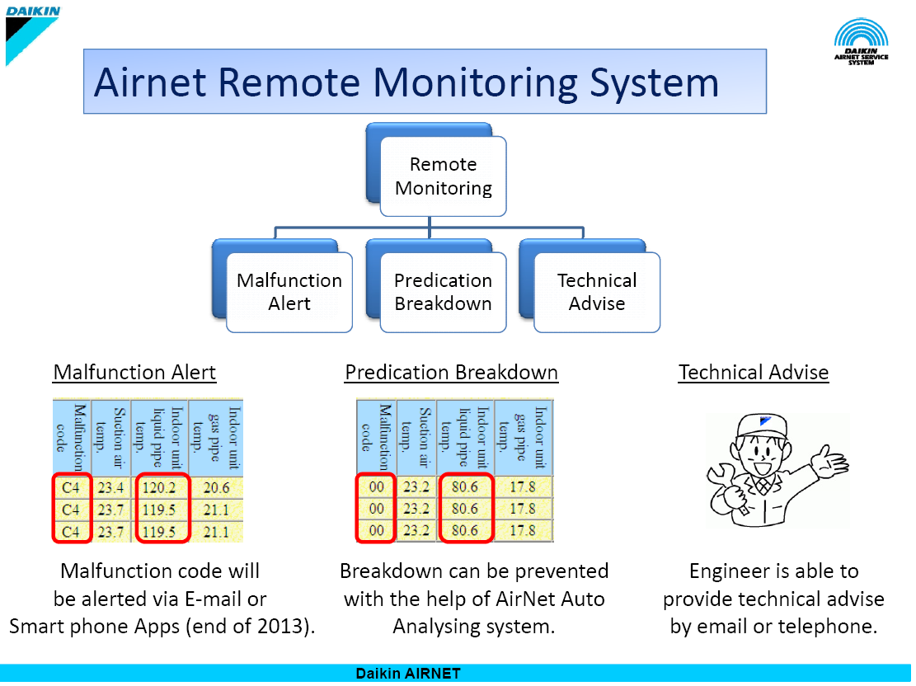

Integration Solutions

Slide 40


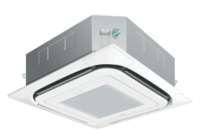
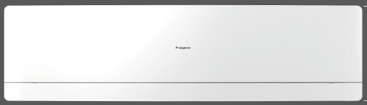

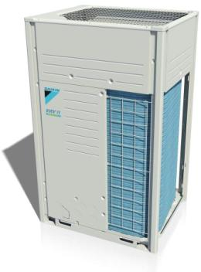

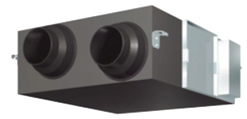
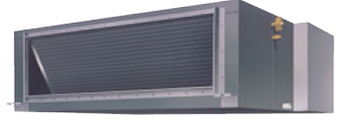

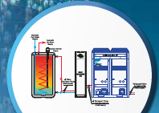
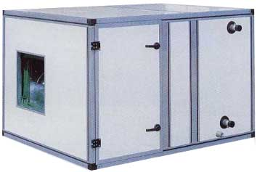
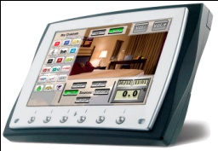

Integration Solutions
1 Sistema, Multiples Aplicaciones
RA unit:
VRV unit:
Pre-Cooled
Fresh air:
HRV:
AHU with DX coil :
Centralize
Control:
ITM

Slide 41
Roof Top
Notes:
From that introduction, let’s go further into the system feature.

Slide 42
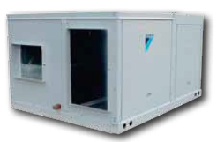
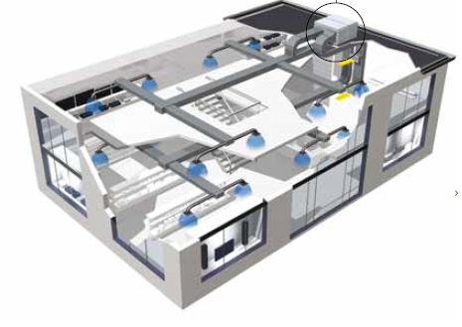
Sistemas Roof Top de Alta eficiencia

Slide 43
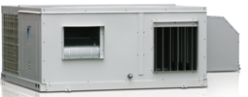
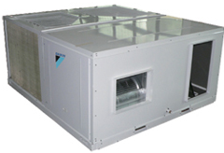
Sistemas Roof Top Alta Eficiencia
UATYQ con Economizador
Serie UATYQ
 |  |  |  | Capacity (Mbtu/hr)
Power Supply | Refrig. | Mode | Model | 60 | 80 | 100 | 120 | 150 | 180 | 210 | 250 | 300 | 350 | 400 | 450
50Hz | R410A | Heatpump | UATYQ
 |  |  |  | Capacity (Mbtu/hr)
Power Supply | Refrig. | Mode | Model | 60 | 80 | 100 | 120 | 150 | 180 | 210 | 250 | 300 | 350 | 400 | 450
50Hz | R410A | Heatpump | UATYQ

Slide 44
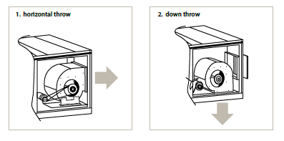
Sistemas Roof Top Alta Eficiencia
 | Number of Compressors | Controller Name | Remote Controller | Air throw configuration | Convertible
UATYQ250MC | 1 | R101 | Rooftop Panel | Side Discharge / Side Return | Yes
UATYQ350MC | 2 | R101 | Rooftop Panel | Side Discharge / Side Return | Yes
UATYQ450MC | 2 | R101 | Rooftop Panel | Side Discharge / Side Return | Yes
UATYQ550MC | 2 | R101 | Rooftop Panel | Side Discharge / Side Return | Yes
UATYQ600MC | 2 | R101 | Rooftop Panel | Side Discharge / Side Return | Yes
UATYQ700MC | 2 | R101 | Rooftop Panel | Side Discharge / Side Return | Yes

Slide 45
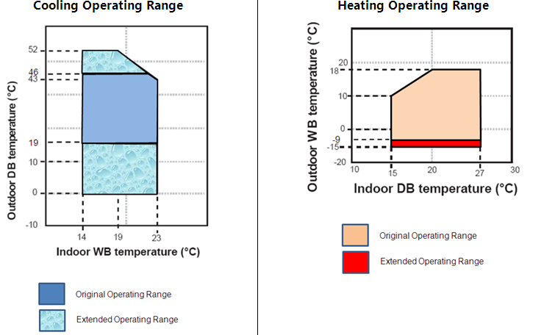
Sistemas Roof Top Alta Eficiencia
Rango de Operación UATYQ

Slide 46
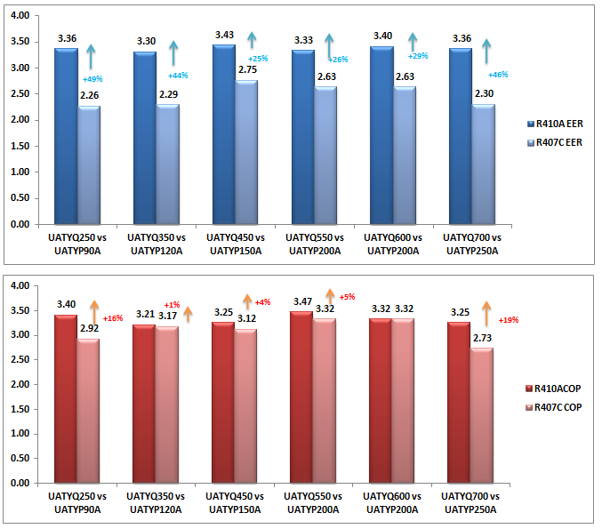
Sistemas Roof Top Alta Eficiencia

Slide 47
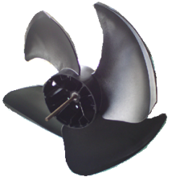
Sistemas Roof Top Alta Eficiencia
-4dBA
-2dBA
+2dBA
-4dBA
-5dBA

Slide 48
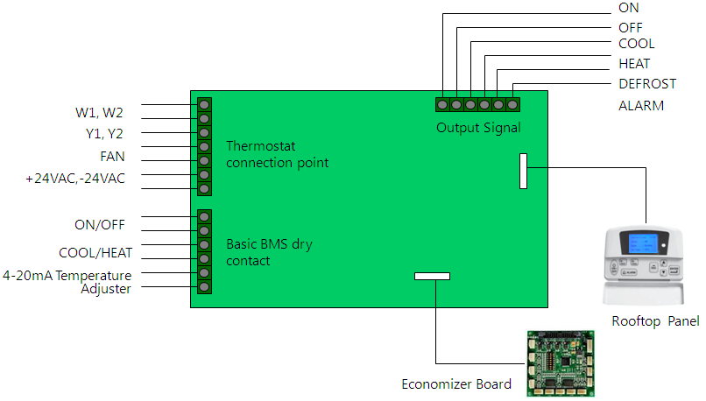
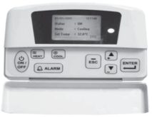
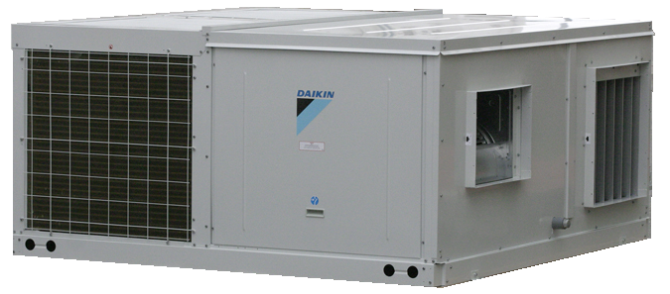
Sistemas Roof Top Alta Eficiencia

Slide 49
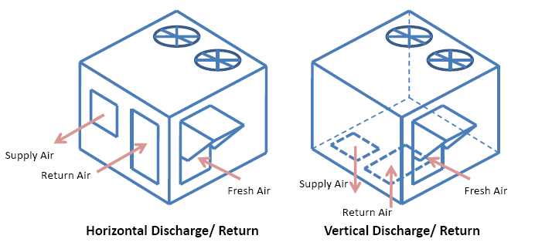
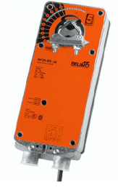
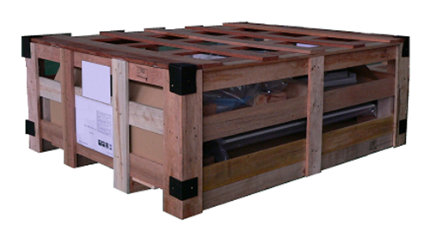
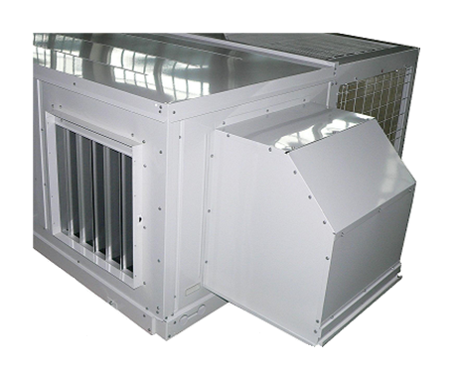
Sistemas Roof Top Alta Eficiencia
Opción de Kit Economizador
Return Air Damper
Damper airefresco + reja+ Saranet Filtro

Slide 50
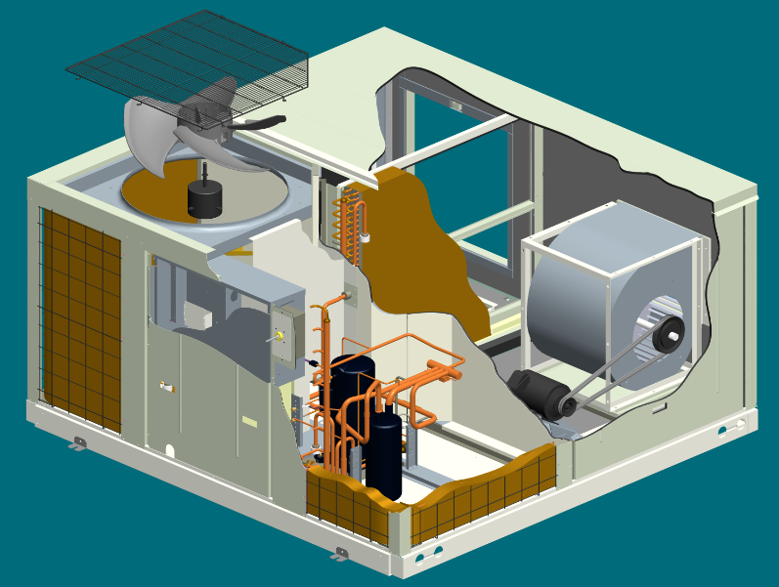
Sistemas Roof Top Alta Eficiencia
Principales Caracteristicas
Paneles de Acero Zincado Pintado
Aislación de PE 10 mm de espesor
Filtro + Ranuras porta Filtros
Motor de Inducción IP44 + Ventilador Axial de bajo nivel sonoro

Slide 51
Sistemas Roof Top Alta Eficiencia
Principales Caracteristicas
Válvula de Expansión Electrónica
Compresor Scroll R410a con protección Interna y calefactor de Carter
Serpentina de Condensador con Gold Fin

Slide 52
Sistemas Roof Top Alta Eficiencia
Principales Caracteristicas
Ventilador balanceado de Impulsión DADE alabes curvados adelante con polea de regulación variable . IP55
Serpentina Evaporador con Goldfin

Slide 53
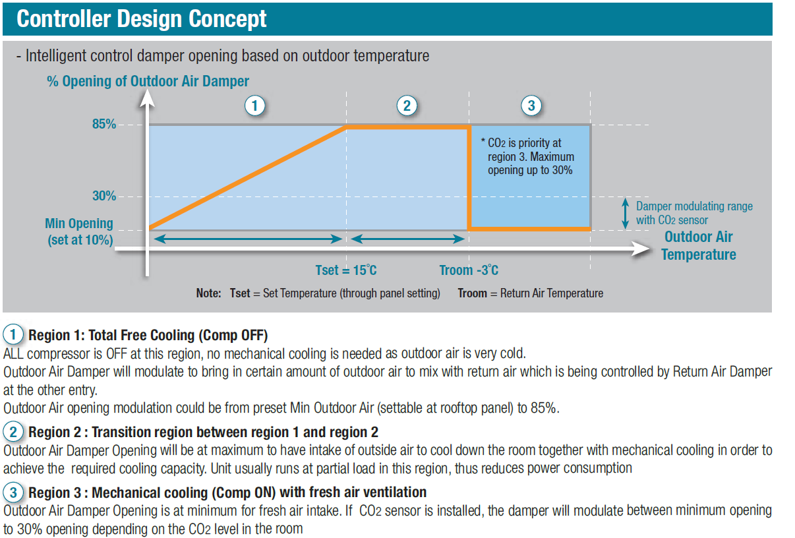
Sistemas Roof Top Alta Eficiencia

