Slide 1


Smart phone
Control System
SVMPR1
SVMPR2

Slide 2


You can control VRV from anywhere in your house through WiFi
You can turn on bed room VRV from living room
before you go to bed

Slide 3
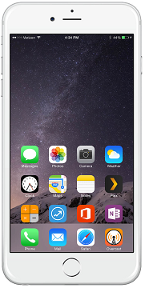
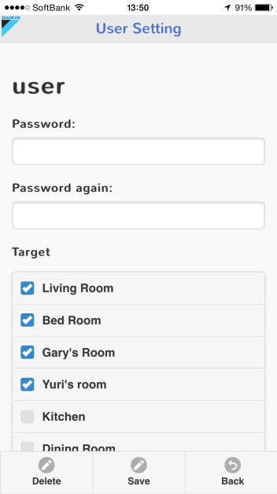
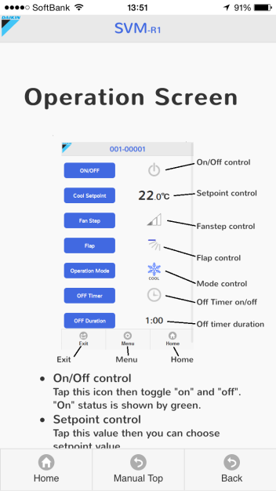
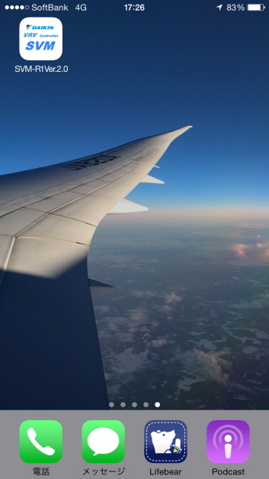
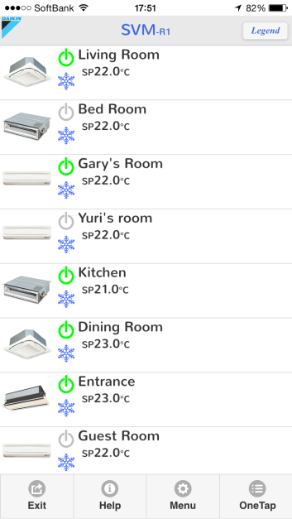
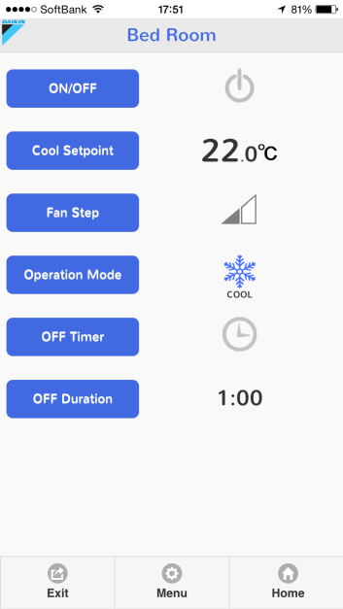
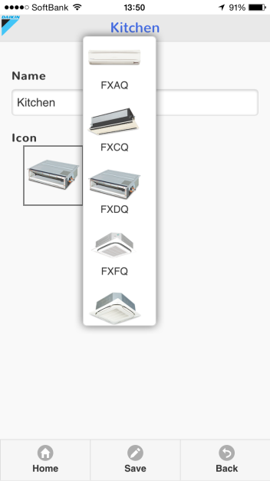
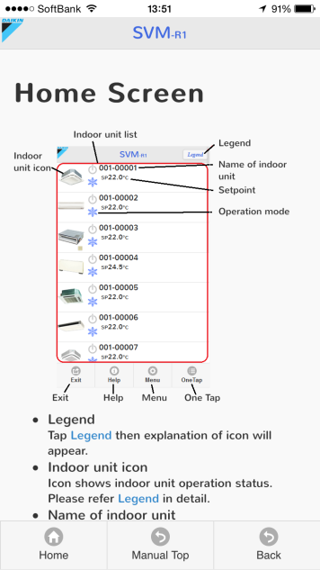
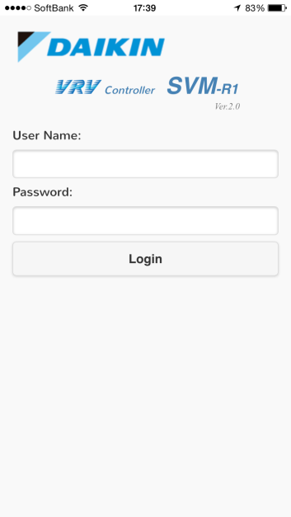
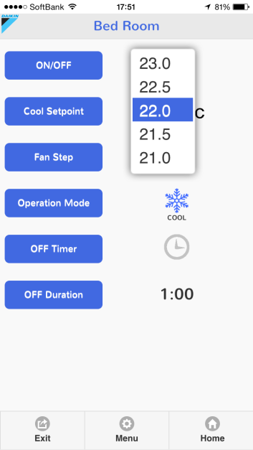

Easy operation makes comfort room environment

Slide 4
What functions can use on your smart phone
Item | Contents
Monitor | Operation status, Setpoint, Operation mode, Fan step, Flap, Error, Error code, Filter sign
Operation | Start/Stop, Setpoint, Operation mode, Fan step, Flap, Filter sign clear, All Start/Stop
Automatic Control | Off Timer Off Timer Duration setup (0:05 – 12:00 5min interval)
System Setup | User registration (only for administrator) Password setting Network setting (only for administrator)
Display Setup | Indoor unit name setting (only for administrator) Indoor unit icon setting (only for administrator)

Slide 5
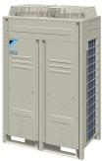

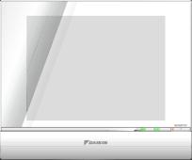
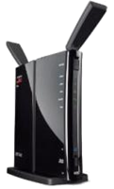
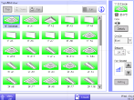

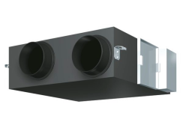
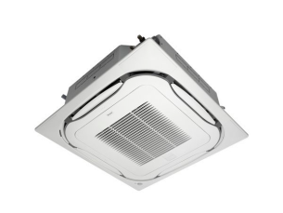
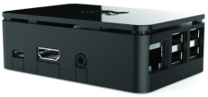
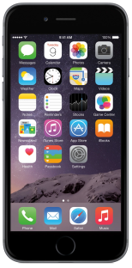


What is required for this system
In the case DCM601A51(or DCS601C51) is already installed
Just add SVMPR2 to VRV system
WiFi router
LAN cable
DCM601A51
(or DCS601C51)
SVMPR2
Up to 64 indoor units can be managed
Not only indoor unit but also other equipment can be managed

